Slide 1



Probability Density Functions
Kalbe Digital University
Notes:
We will continue our journey to learn exploratory data analysis.
In this lecture, we will learn about the Probability Density Function (PDF) that provides a foundational tool to understand the distribution of continuous data. Essentially, a PDF represents the likelihood of a continuous random variable falling within a particular range of values. By graphing the PDF, one can visualize the shape of a distribution, identifying modes, skewness, kurtosis, and potential outliers. This not only offers insights into the characteristics of the dataset but also aids in making informed decisions about subsequent statistical analyses and modeling techniques.
Utilizing PDFs in EDA, therefore, serves as a preliminary step to gauge the behaviour and tendencies of continuous datasets.
So lets begin….

Slide 2
1
What is PDFs
2
Kernel Density Estimation
Outline
3
The Distribution Frameworks
of
Histogram Implementation
PMF Implementation
CDF Implementation
Probability Density
Functions
4
Moments
5
Skewness
6
Summary
Notes:
This lecture commences with an introduction to PDFs, showcasing their essence in representing the distribution of a dataset. It then navigates into the Kernel Density Estimation, a nuanced technique that offers a non-parametric approximation of the underlying probability density function. This method smoothens sample data points, laying out a clearer picture of the true distribution. As we delve deeper, the emphasis shifts to the various Distribution Frameworks, highlighting the importance of pinpointing the most fitting framework, whether it be normal, exponential, or binomial, among others, for a precise statistical interpretation.
Expanding on representation techniques, this lecture introduces the Histogram Implementation, a visual tool that segments and portrays data distribution, giving a tangible sense of the estimated PDF. For discrete datasets, the Probability Mass Function (PMF) becomes pertinent, detailing the specific probabilities of distinct values. In a similar vein, the Cumulative Distribution Function (CDF) encapsulates the aggregated probabilities up to a given value. Venturing into the territory of Moments, the lecture touches upon measures like mean, variance, and the all-important Skewness, which reveals data asymmetry. Concluding, the lecture underscores the significance of PDFs in data analysis, highlighting the myriad tools and techniques that facilitate a comprehensive understanding of data distributions.
So lets start with the first topic, what is PDF.

Slide 3
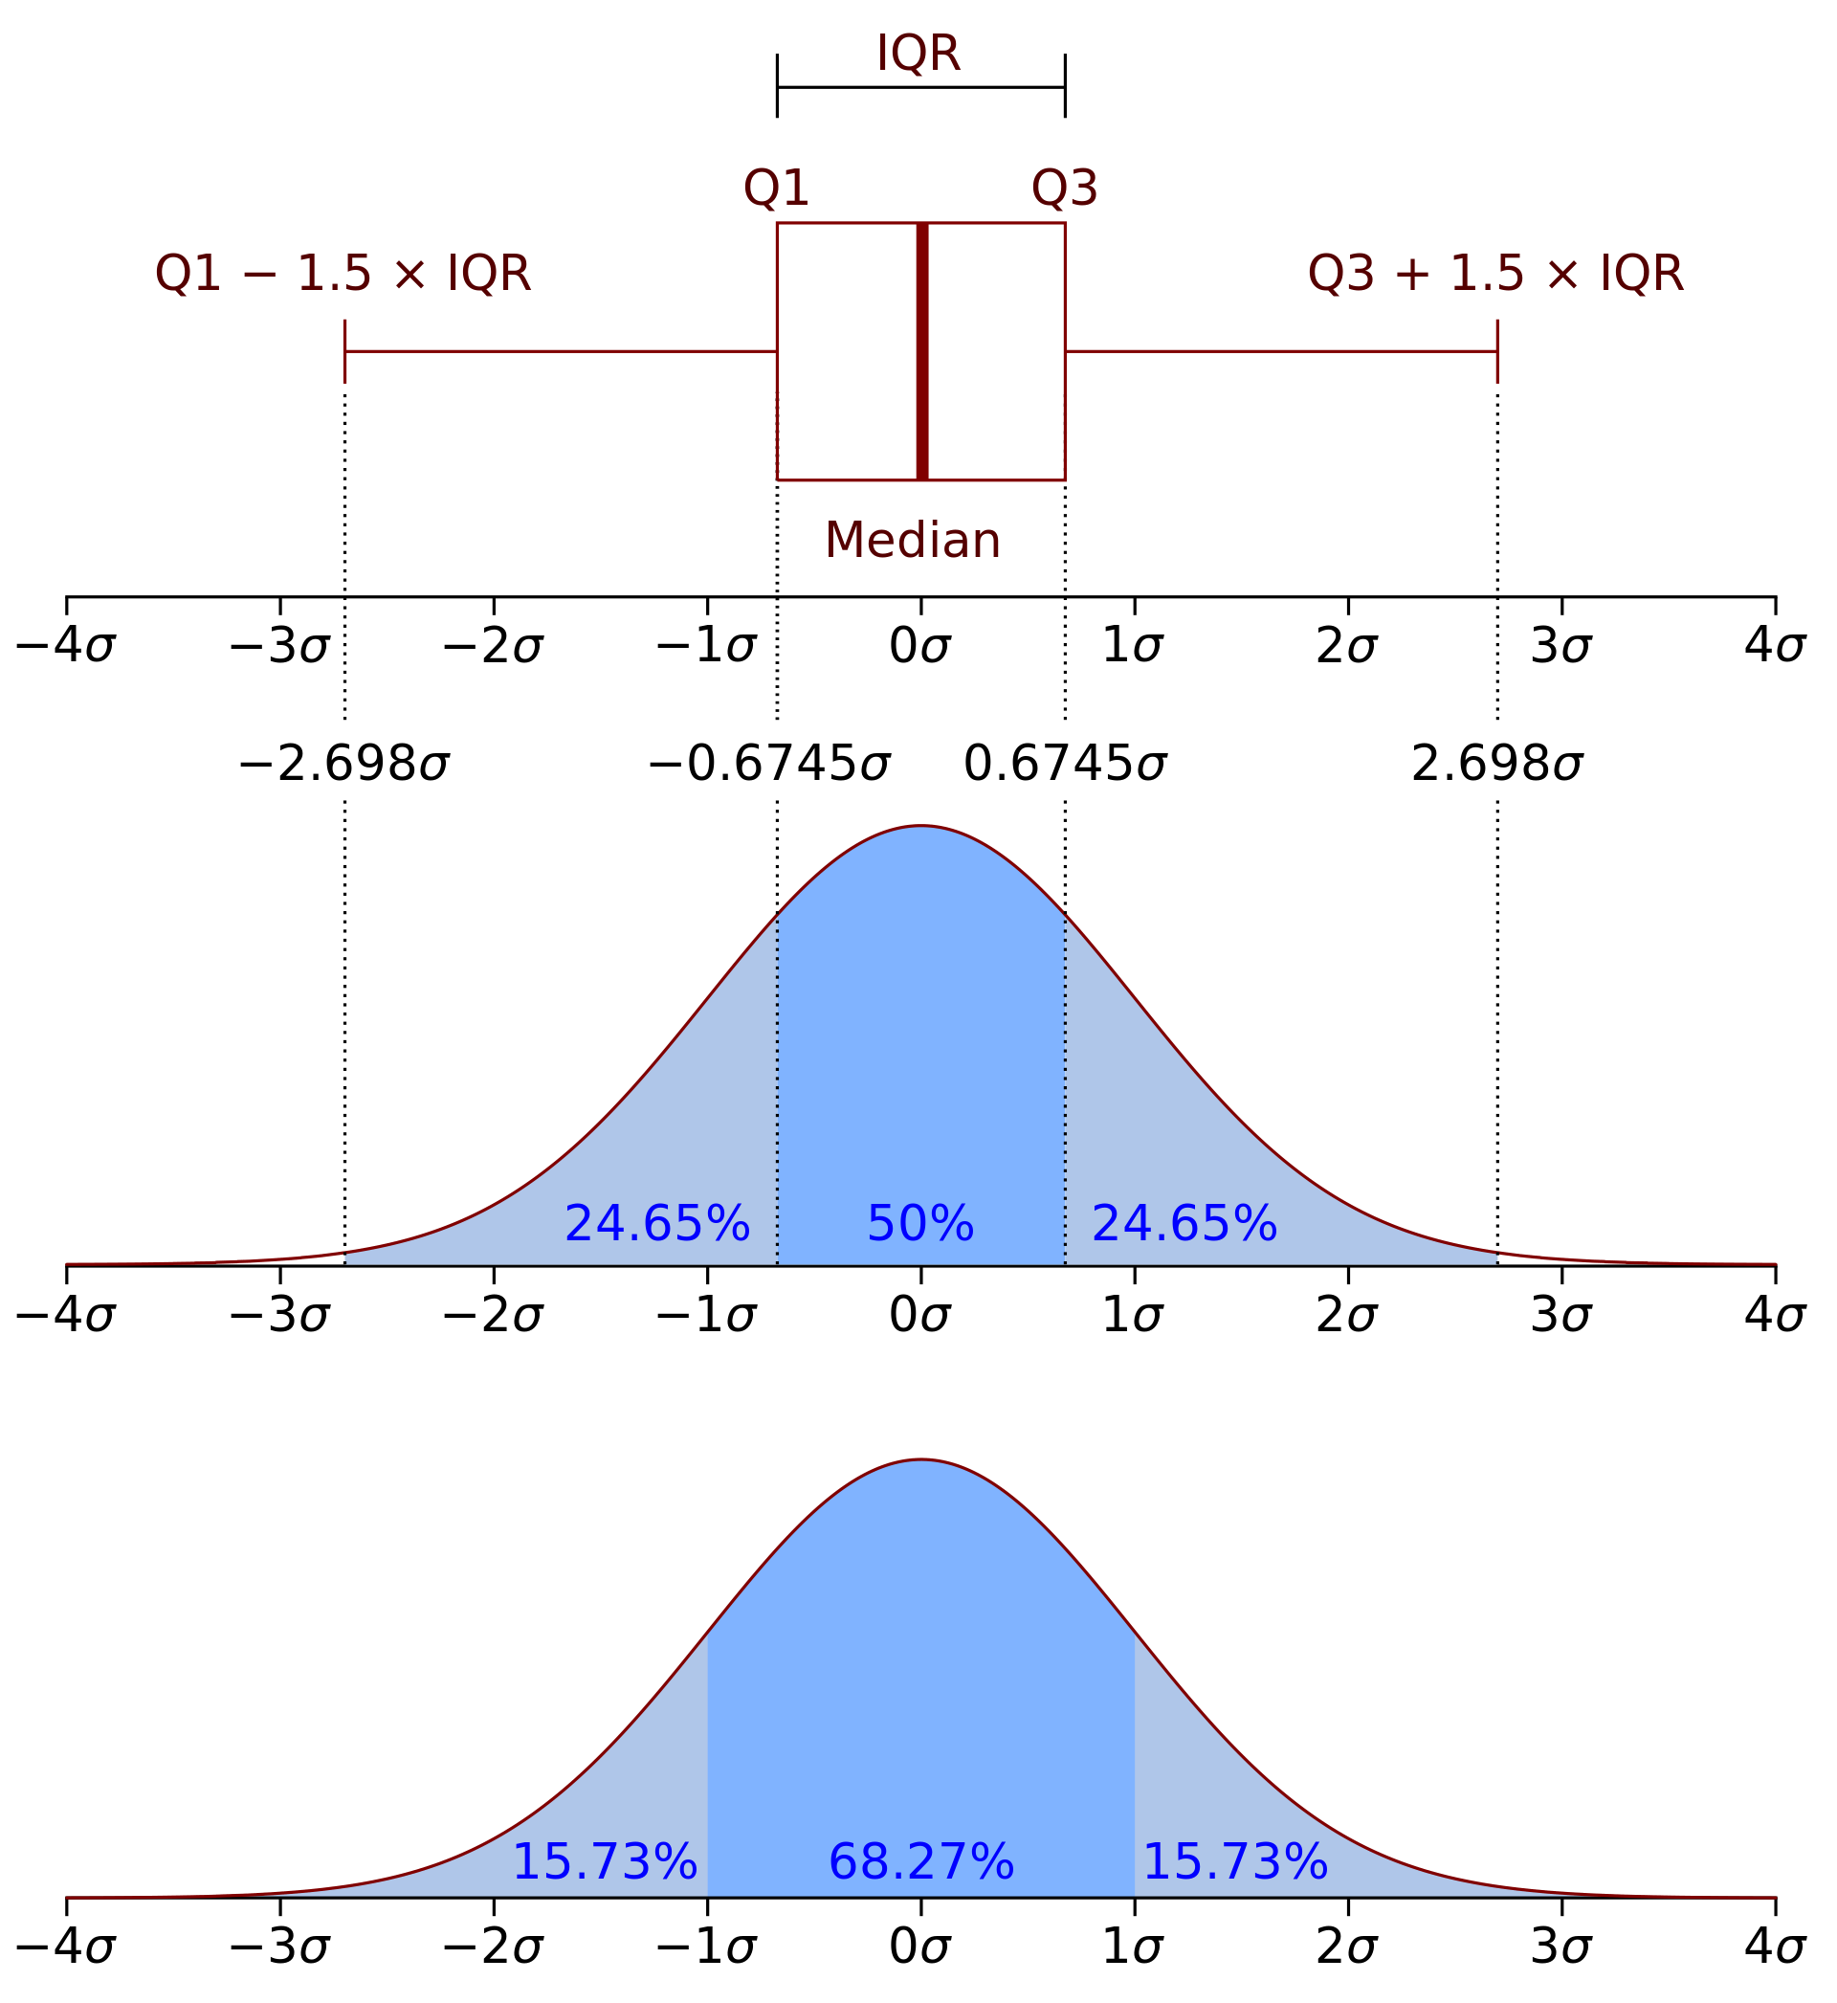
What is PDF
The PDF offers a visualization or mathematical representation of how values of a variable are distributed over its range.
Importance of PDF for Data Scientist:
Insight into Data Distribution
Anomaly Detection
Assumption Checking
Predictive Modeling
Data Transformation Decisions
Notes:
Essentially, the PDF offers a visualization or mathematical representation of how values of a variable are distributed over its range. In a more precise sense, the PDF is used to specify the probability of the random variable falling within a particular range of values, as opposed to taking on any one value. This probability is given by the integral of this variable's PDF over that range—that is, it is given by the area under the density function but above the horizontal axis and between the lowest and greatest values of the range. The probability density function is nonnegative everywhere, and the area under the entire curve is equal to 1.
Understanding the PDF is crucial for data scientists for several reasons:
A glance at the PDF can give immediate insights into the central tendency, spread, and overall shape of the data. Recognizing these patterns is fundamental for determining suitable modeling techniques or further data processing steps.
Peaks, valleys, or unexpected shapes in a PDF can hint at outliers or anomalies in the data, which might need further investigation.
Many statistical methods and machine learning algorithms operate under assumptions about data distribution, like normality. The PDF aids in visually confirming or refuting such assumptions.
For modeling continuous response variables, understanding the underlying PDF can be pivotal in defining the likelihood functions, especially in probabilistic models.
Upon observing the shape of the PDF, a data scientist might decide to apply certain transformations (like log or square root) to stabilize variance or make the data more "normal.”
In essence, grasping the intricacies of the PDF provides data scientists with the ability to make informed decisions throughout the data analysis pipeline, from preprocessing stages to advanced modeling. In this lecture, PDF is used when the probability distribution is defined as a function over general sets of values or it may refer to the cumulative distribution function (CDF), or it may be a probability mass function (PMF) rather than the density. "Density function" itself is also used for the PMF, leading to further confusion. In general though, the PMF is used in the context of discrete random variables (random variables that take values on a countable set), while the PDF here is used in the context of continuous random variables.
So lets continue…

Slide 4
Practical Use Cases in Manufacturing
Defect Detection
Machine Performance
Material Strength
Production Time Analysis
Inventory Management
Maintenance Predictions
Supplier Quality Control
Process Variability
Energy Consumption
PDF as valuable tool in manufacturing for analyzing & understanding continuous data distributions.
Notes:
Essentially, the PDF offers a visualization or mathematical representation of how values of a variable are distributed over its range. In a more precise sense, the PDF is used to specify the probability of the random variable falling within a particular range of values, as opposed to taking on any one value. This probability is given by the integral of this variable's PDF over that range—that is, it is given by the area under the density function but above the horizontal axis and between the lowest and greatest values of the range. The probability density function is nonnegative everywhere, and the area under the entire curve is equal to 1.
Understanding the PDF is crucial for data scientists for several reasons:
A glance at the PDF can give immediate insights into the central tendency, spread, and overall shape of the data. Recognizing these patterns is fundamental for determining suitable modeling techniques or further data processing steps.
Peaks, valleys, or unexpected shapes in a PDF can hint at outliers or anomalies in the data, which might need further investigation.
Many statistical methods and machine learning algorithms operate under assumptions about data distribution, like normality. The PDF aids in visually confirming or refuting such assumptions.
For modeling continuous response variables, understanding the underlying PDF can be pivotal in defining the likelihood functions, especially in probabilistic models.
Upon observing the shape of the PDF, a data scientist might decide to apply certain transformations (like log or square root) to stabilize variance or make the data more "normal.”
In essence, grasping the intricacies of the PDF provides data scientists with the ability to make informed decisions throughout the data analysis pipeline, from preprocessing stages to advanced modeling. In this lecture, PDF is used when the probability distribution is defined as a function over general sets of values or it may refer to the cumulative distribution function (CDF), or it may be a probability mass function (PMF) rather than the density. "Density function" itself is also used for the PMF, leading to further confusion. In general though, the PMF is used in the context of discrete random variables (random variables that take values on a countable set), while the PDF here is used in the context of continuous random variables.
So lets continue…

Slide 5
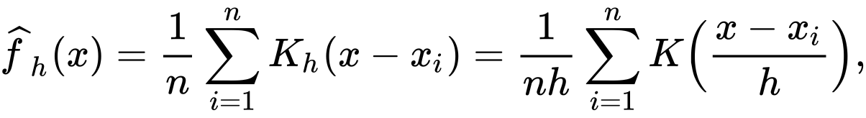
Kernel Density Estimation
Kernel Density Estimation (KDE) is a non-parametric method to estimate the probability density function (pdf) of a continuous random variable. It provides a smoothed version of the histogram and is a way to recover the underlying distribution of a dataset.
KDE Use Cases:
Understanding Salary Distributions
Customer Transaction Patterns
Fraud Detection
Customer Onboarding Patterns
Loan Application Patterns
Credit Score Distribution
User Login Patterns
FORMAL DEFINITION: Let (x₁, x₂, ..., x_{n}) be independent and identically distributed samples drawn from some univariate distribution with an unknown density ƒ at any given point x. We are interested in estimating the shape of this function ƒ. Its kernel density estimator is:
where K is the kernel — a non-negative function — and h > 0 is a smoothing parameter called the bandwidth. A kernel with subscript h is called the scaled kernel and defined as K_{h}(x) = 1/h K(x/h).
Notes:
We will start the Probability Density Function (PDF) lecture with Kernel Density Estimation (KDE). KDE is a non-parametric method used to estimate the probability density function (PDF) of a continuous variable in the context of Manufacturing 4.0. It provides a smoothed representation of the data distribution and helps recover the underlying distribution in a dataset. Given a set of data points, KDE generates a smoothed estimate of the distribution using a kernel function, which is a non-negative function. The shape and smoothness of the estimated distribution are controlled by a parameter known as the bandwidth (h). In this formal definition, a scaled version of the kernel is used in the estimation process. The choice of kernel and bandwidth are critical in ensuring the accuracy and interpretability of the KDE results. Common kernels used in Manufacturing 4.0 scenarios include Gaussian, Epanechnikov, and Tophat, among others. Selecting the appropriate bandwidth is one of the key challenges in KDE. A small bandwidth can result in overfitting, while a large one can oversmooth the data. Common methods for bandwidth selection include Silverman's Rule or cross-validation techniques.
KDE can be applied to various exploratory data analysis (EDA) scenarios in the context of Manufacturing 4.0, for example:
1. **Quality Control**: By applying KDE to product quality data, manufacturers can identify peaks in the distribution that correspond to common quality levels or defects.
2. **Machine Performance Analysis**: To identify common performance metrics or frequency of machine breakdowns. For instance, understanding when machines tend to require maintenance can aid in predictive maintenance strategies.
3. **Energy Consumption Patterns**: By comparing the KDE of normal energy consumption with new data, manufacturers can detect unusual energy usage patterns that might indicate equipment malfunction or inefficiencies.
4. **Production Scheduling**: Understanding the distribution of production cycle times, lead times, or job completion durations to optimize scheduling and resource allocation.
5. **Supplier Quality Assessment**: KDE can help manufacturers understand the quality distribution of components or materials from different suppliers, aiding in supplier selection and quality control.
6. **Resource Utilization**: Manufacturers can analyze the distribution of resource usage (e.g., raw materials, labor, energy) to optimize resource allocation and reduce waste.
7. **Maintenance Predictions**: By studying the probability distribution of equipment failure times, manufacturers can predict maintenance needs and minimize production downtime.
8. **Process Variability**: Examining the probability density of process parameters to identify sources of variability and enhance process control in a manufacturing facility.
Kernel Density Estimation is a versatile tool that can be used to gain valuable insights into data distributions and improve decision-making in the context of Manufacturing 4.0. The choice of specific applications depends on the manufacturing processes and data available.

Slide 6
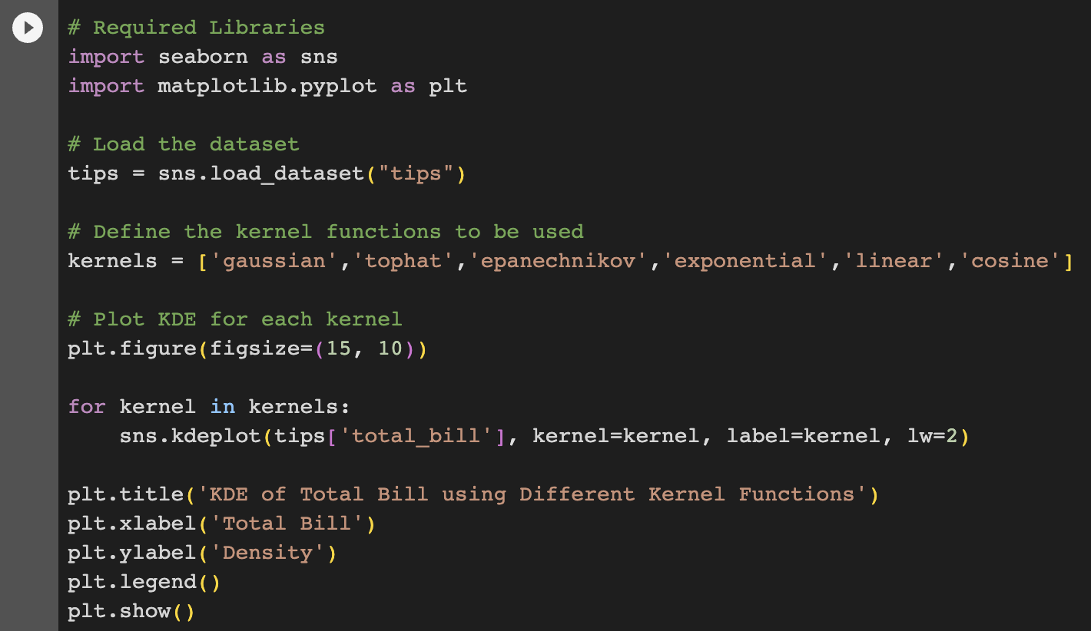
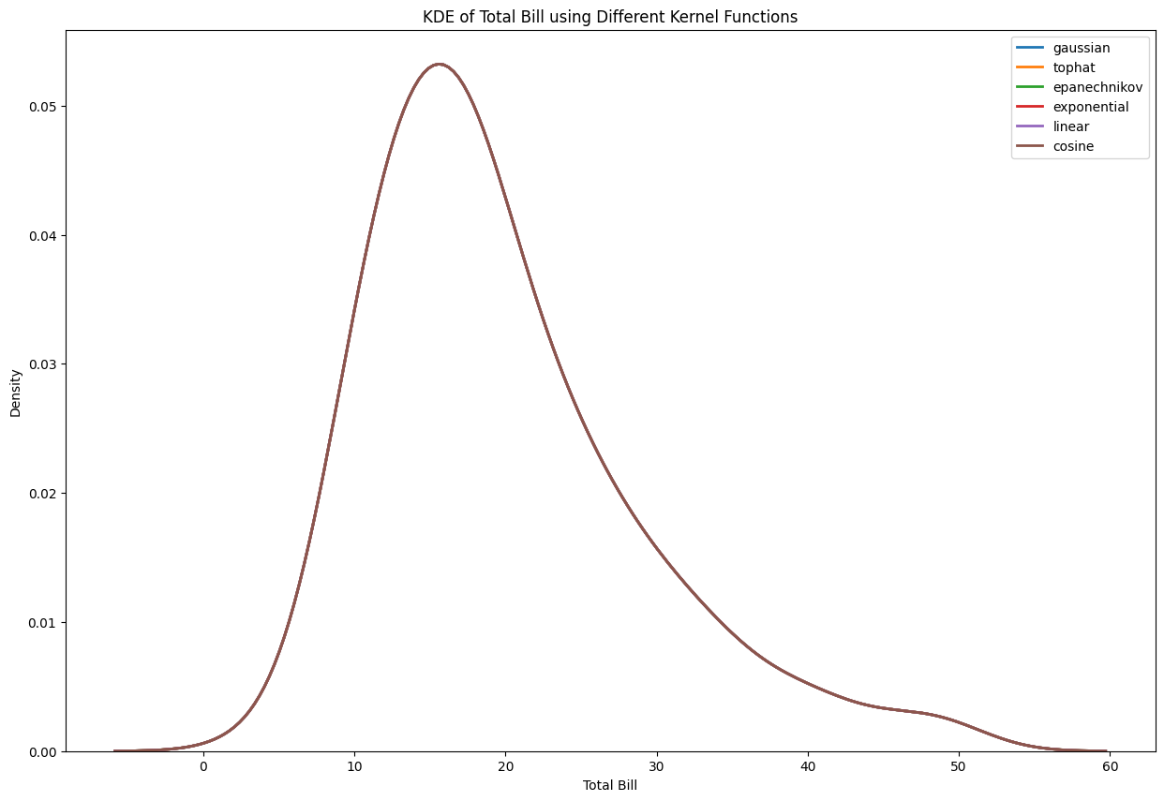
KDE with Different Kernel Functions
Dataset: Tips
Libraries: Seaborn
Notes:
Let's use the tips dataset from the seaborn library to demonstrate the KDE. In this example, we'll analyze the distribution of total bills using Kernel Density Estimation.
Here in this sample codes, we show that different kernel functions not really change the shape of tips distribution. However, the choice of kernel can sometimes be subjective and might depend on the specific nature of the data or the purpose of the analysis.
You can further refine the KDE by experimenting with different bandwidths using the bw parameter in the kdeplot function.

Slide 7
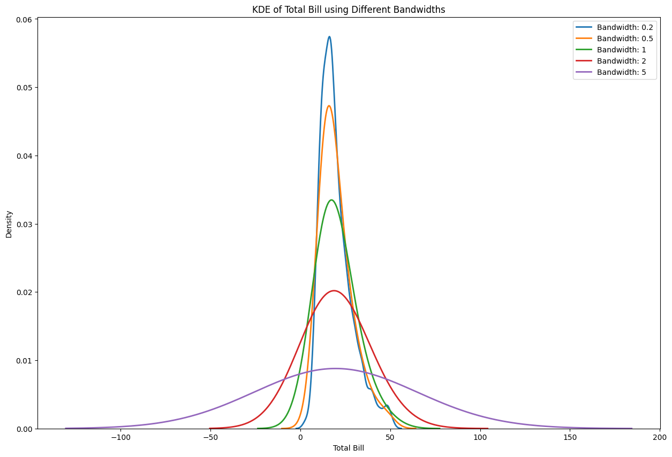
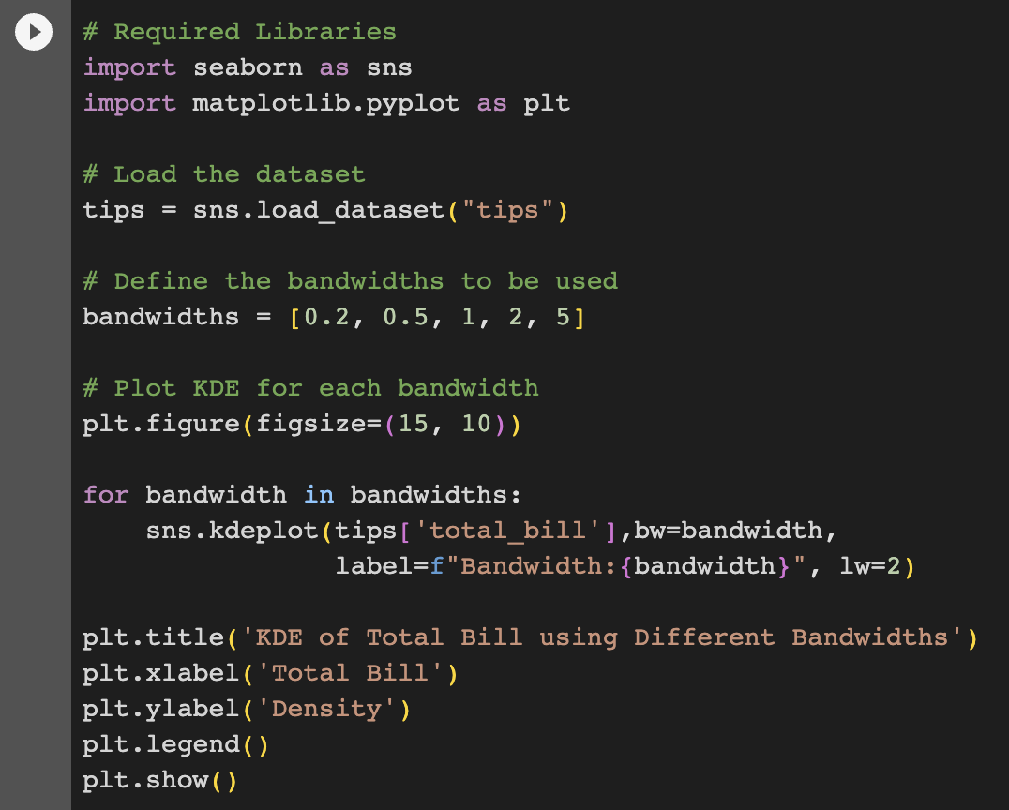
KDE with Different Bandwidth
Dataset: Tips
Libraries: Seaborn
Notes:
The bandwidth is a key parameter in KDE that determines the width of the kernel at each data point. A small bandwidth will result in a more sensitive curve that may overfit to minor fluctuations in the data, while a large bandwidth can oversimplify the shape of the distribution.
In this example, you'll see how changing the bandwidth affects the KDE plot. A smaller bandwidth gives a more jagged plot that can detect smaller changes, while a larger bandwidth provides a smoother appearance. It's important to choose an appropriate bandwidth based on the nature of the data and the goals of your analysis.

Slide 8
The Distribution Frameworks
Standard Distributions:
Normal, Exponential, Binomial, Poisson
Parameter Estimation:
Mean and Standard Deviation
Fitting Distributions:
Kolmogorov-Smirnov test
Continuous vs Discrete:
Choice is based on nature of data
Transformations:
Sometime Data does not adhere to standard distribution
Multivariate Distribution:
Multiple variable correlation and join behaviours
Non-Parametric Distributions:
Use KDE instead
Notes:
Now lets continue our lecture to other related topic.
Here, term "Distribution Frameworks" generally refers to the theoretical models and structures that underpin various probability distributions. These frameworks guide our understanding of data's underlying behavior and provide a foundation for modeling and analyzing various types of random variables and observed datasets. Understanding distribution frameworks in the context of PDFs is pivotal in exploratory data analysis. It provides data scientists and statisticians with tools to summarize, model, and make inferences about the underlying structure and behavior of observed data.
Lets review some contexts in distribution frameworks.
There are several standard probability distributions that have already studied in depth, such as the Normal, Exponential, Binomial, and Poisson distributions. These distributions have specific shapes, moments (like mean and variance), and properties.
Most distributions are characterized by parameters. For instance, a normal distribution is defined by its mean and standard deviation. Part of the analysis often involves estimating these parameters from the observed data.
In EDA and data analysis, a common task is to determine which theoretical distribution fits the empirical data best. Goodness-of-fit tests, like the Kolmogorov-Smirnov test, can be used for this purpose.
Distributions can be categorized into continuous (like the Normal distribution) or discrete (like the Binomial distribution). The choice of distribution often depends on the nature of the data.
Sometimes, data doesn't adhere to standard distributions. In such cases, transformations (e.g., log transformations) can make the data resemble a standard distribution more closely, facilitating further analysis.
While many EDA tasks focus on univariate distributions, it's essential to recognize that multivariate distributions exist. These distributions describe the behavior of multiple variables together, accounting for correlations and joint behaviors.
Not all data can be fit using standard parametric distributions. In such cases, non-parametric methods, like Kernel Density Estimation (KDE), can be used to estimate the PDF without making strict assumptions about the data's underlying distribution.
The distribution frameworks can involve various type of implementations such as Histogram, PMF and CDF that we already discussed in previous lecture.

Slide 9

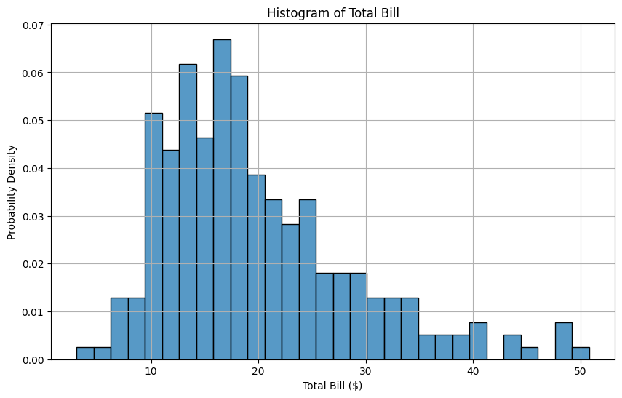
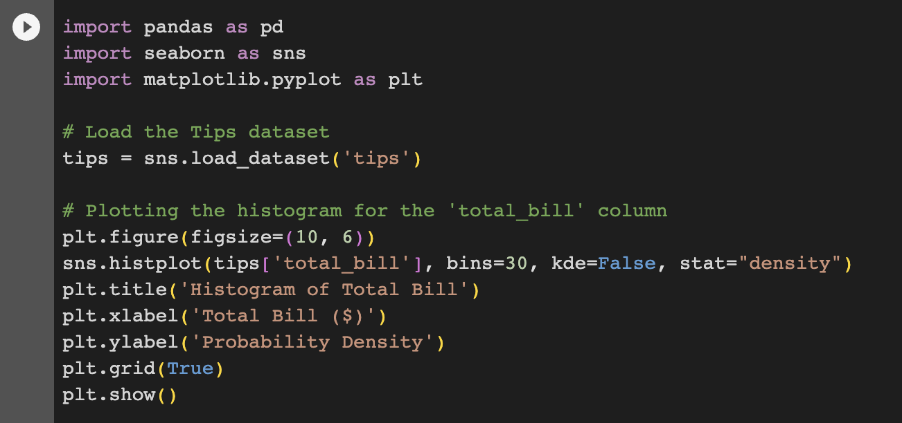
Histogram Implementation
ChatGPT: Explain about Histogram implementation for probability density functions with sample codes in Python using Tips dataset.
Notes:
Let start with Histogram implementation.
A histogram is a graphical representation of the distribution of a dataset. When dealing with probability density functions (PDFs), histograms can be thought of as a way to estimate the underlying distribution of data. Essentially, the histogram divides the data into bins, counts the number of data points that fall into each bin, and then visualizes these counts. In the context of PDFs, the area under the histogram can be normalized to represent probabilities rather than raw counts. When normalized this way, a histogram can provide an empirical estimation of the data's PDF.
Using the Tips dataset as an example, let's visualize a histogram for the total_bill column. You can get these codes by simply prompting to ChatGPT. This histogram showcases the distribution of total bills in the dataset. The y-axis represents the probability density, ensuring the area under the histogram equals 1. By visually inspecting the histogram, we can gather insights about the distribution of the total_bill values, such as central tendency, spread, and potential outliers.
When using histograms to estimate PDFs, it's crucial to select an appropriate bin width. Too few bins might oversimplify the data's distribution, while too many bins might introduce noise. The bins argument in the histplot function allows you to control the number of bins used.

Slide 10
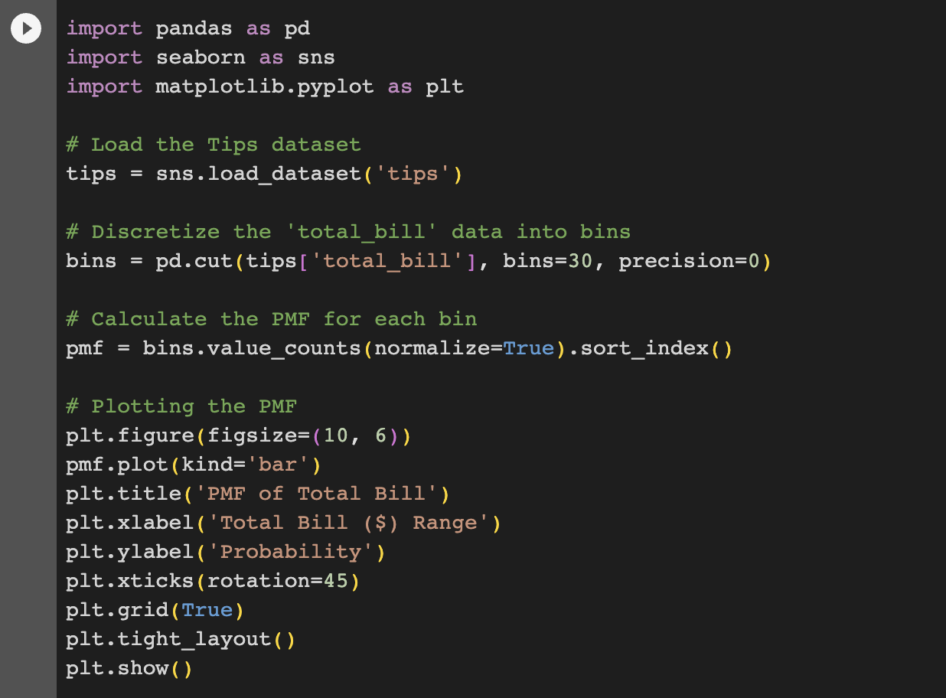
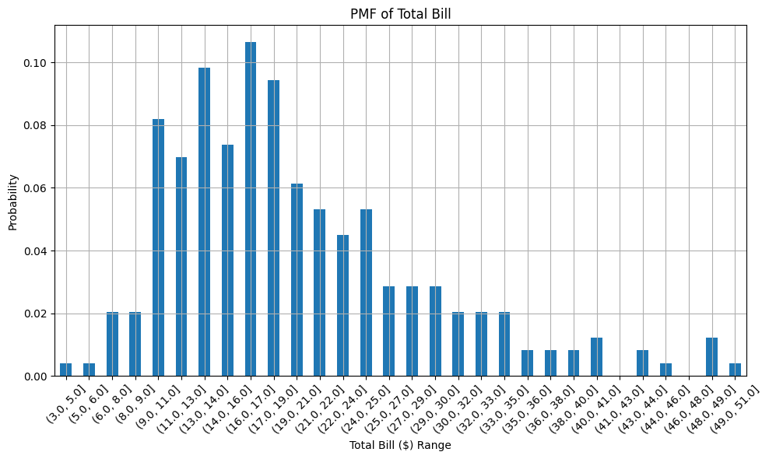
PMF Implementation
ChatGPT: Explain about PMF implementation for probability density functions with sample codes in Python using Tips dataset.
Notes:
Now let see PMF implementation.
The Probability Mass Function (PMF) is a function that gives the probability that a discrete random variable is exactly equal to some value. The difference between a PMF and a histogram in terms of continuous data is that a PMF will give probabilities for specific discrete outcomes, while histograms or PDFs give you the density of data over an interval. For discrete data, the PMF is a direct representation of probabilities. For continuous or quasi-continuous data (like the "total_bill" column in the Tips dataset), we need to discretize the data to use a PMF effectively, typically by grouping data into bins.
Here's how you might implement a PMF for the total_bill column of the Tips dataset using Python. Don’t worry about sample codes, as you can always prompt to ChatGPT.
In this code, the pd.cut() function is used to divide the "total_bill" data into 30 bins. Then, we compute the PMF for each bin. Finally, we plot the PMF using a bar plot.

Slide 11
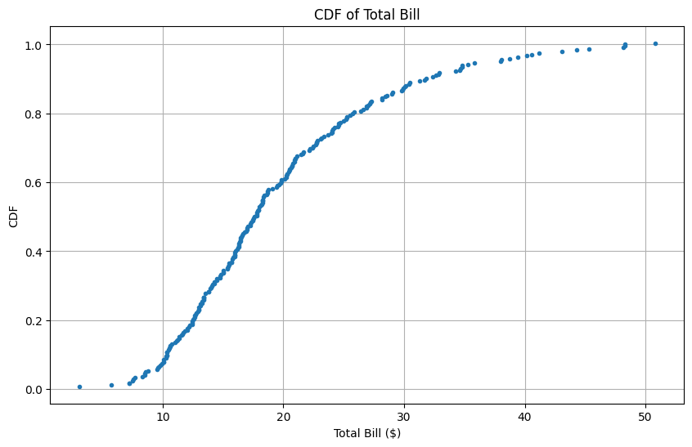
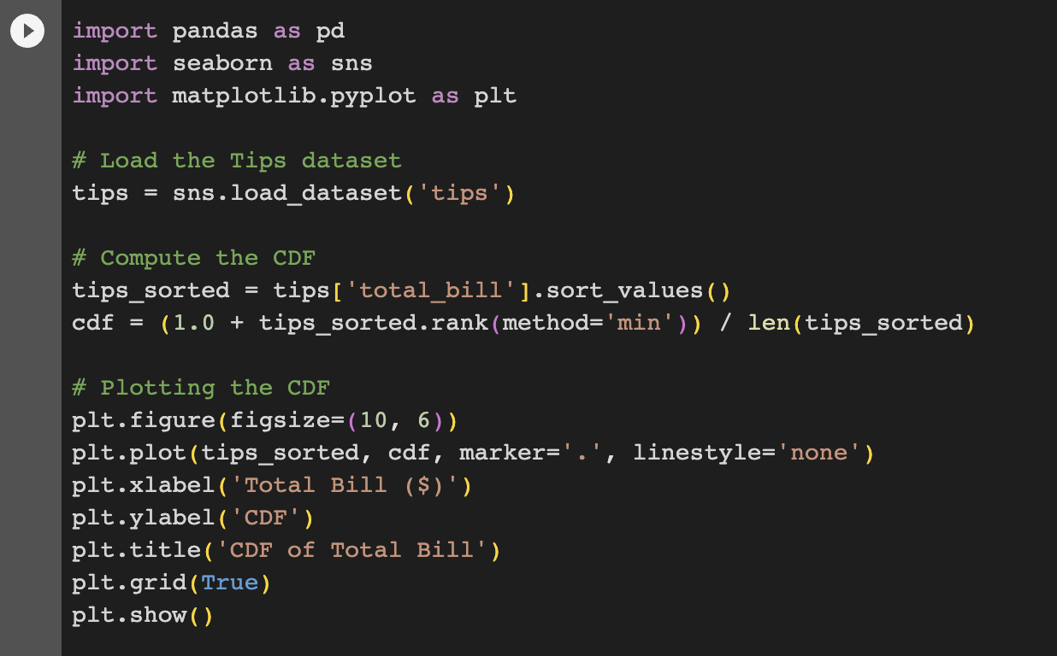
CDF Implementation
ChatGPT: Explain about CDF implementation for probability density functions with sample codes in Python using Tips dataset.
Notes:
Another implementation is CDF.
The Cumulative Distribution Function (CDF) gives the probability that a random variable is less than or equal to a certain value. It's a fundamental tool in statistics and is particularly useful in exploratory data analysis for understanding the distribution of data points.
For a dataset, the CDF is simply the fraction of data points less than or equal to a particular value. It's a monotonically increasing function that ranges between 0 (indicating that none of the data is below the given value) and 1 (indicating that all of the data is below the given value).
Here's how you can compute and plot the CDF for the total_bill column of the Tips dataset using Python. This code first sorts the values in the total_bill column. Then, it computes the CDF by ranking each data point and dividing by the total number of data points. The resulting CDF is then plotted against the sorted values of total_bill.
From the CDF plot, you can quickly determine the fraction of bills that are below a certain value. For instance, if you wish to know the fraction of bills below $20, you simply find $20 on the x-axis and look at the corresponding y-value on the CDF plot.

Slide 12
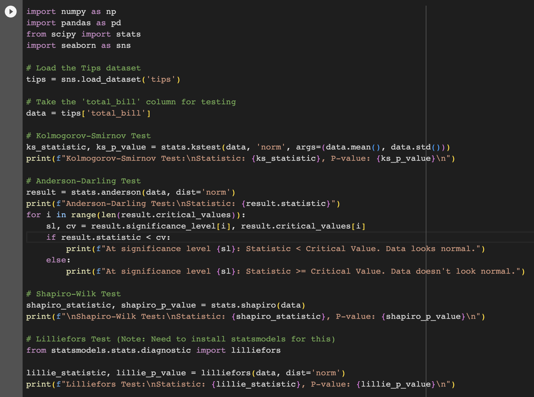
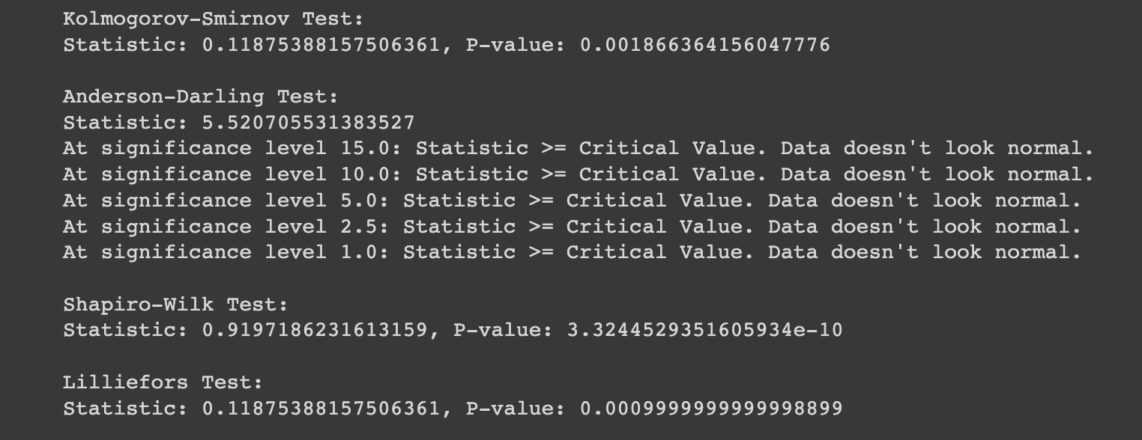
Goodness of Fit Test
Determine if a sample comes from a specified distribution. In other words, it helps to determine the suitability of a distribution to a dataset.
Kolmogorov-Smirnov test
Anderson-Darling Test
Shapiro-Wilk Test
Lilliefors Test
Notes:
On of common usage of PDF is for testing. We usually use Goodness-of-fit tests are used to determine if a sample comes from a specified distribution, for example normal distribution. In other words, it helps to determine the suitability of a distribution to a dataset.
Some of the non-parametric methods are listed here.
Kolmogorov-Smirnov Test (K-S Test): This is a non-parametric test that compares the cumulative distribution function (CDF) of the sample data with the CDF of a specified theoretical distribution or another empirical distribution.
Anderson-Darling Test: This test gives more weight to the tails than the K-S test. It's used to test data against a number of distributions (including normal, exponential, and logistic).
Shapiro-Wilk Test: This test specifically tests for the normality of data. It's a widely accepted test for this purpose.
Lilliefors Test: This is an adaptation of the K-S test for situations where parameters are estimated from the data. It's often used when the sample size is small.
Using these tests on the Tips dataset, one can determine if the 'total_bill' column (or any other numeric column) follows a normal distribution or not. You can ask ChatGPT to give sample codes for tips dataset and here is the result.
P-value: For all the tests, if the p-value is less than a chosen alpha level (e.g., 0.05), the null hypothesis that the data comes from the chosen distribution is rejected.
For the Anderson-Darling test, the test statistic is compared with critical values at various significance levels. If the statistic is larger than the critical value, then for that significance level, the null hypothesis that the data comes from the chosen distribution is rejected.

Slide 13
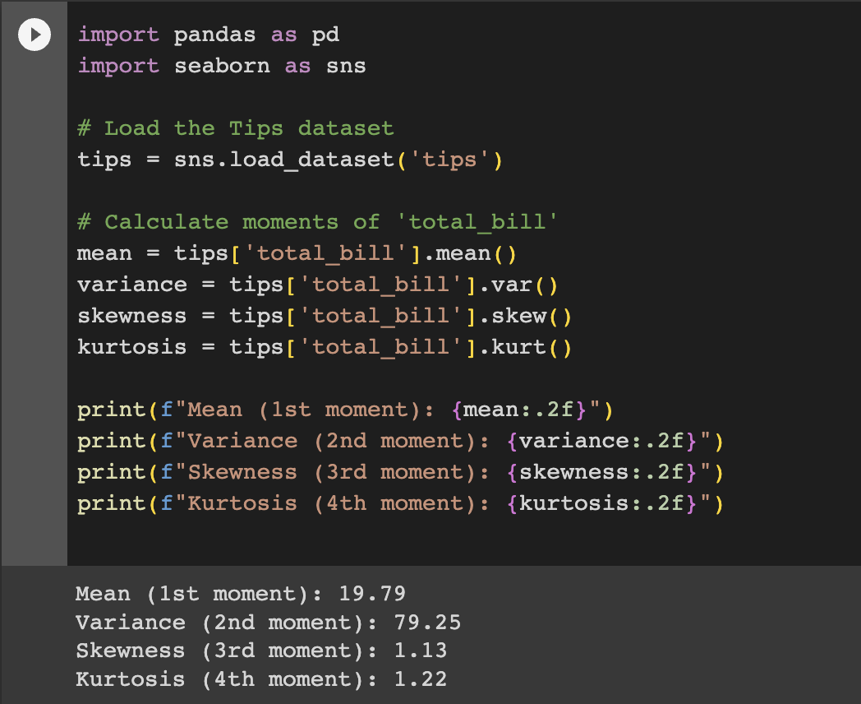
Moments
The moments give an insight into the characteristics and features of a distribution. They include the following:
Zeroth Moment
First Moment (Mean)
Second Moment (Variance)
Third Moment (Skewness)
Fourth Moment (Kurtosis)
Notes:
On of common usage of PDF is for testing. We usually use Goodness-of-fit tests are used to determine if a sample comes from a specified distribution, for example normal distribution. In other words, it helps to determine the suitability of a distribution to a dataset.
Some of the non-parametric methods are listed here.
Kolmogorov-Smirnov Test (K-S Test): This is a non-parametric test that compares the cumulative distribution function (CDF) of the sample data with the CDF of a specified theoretical distribution or another empirical distribution.
Anderson-Darling Test: This test gives more weight to the tails than the K-S test. It's used to test data against a number of distributions (including normal, exponential, and logistic).
Shapiro-Wilk Test: This test specifically tests for the normality of data. It's a widely accepted test for this purpose.
Lilliefors Test: This is an adaptation of the K-S test for situations where parameters are estimated from the data. It's often used when the sample size is small.
Using these tests on the Tips dataset, one can determine if the 'total_bill' column (or any other numeric column) follows a normal distribution or not. You can ask ChatGPT to give sample codes for tips dataset and here is the result.
P-value: For all the tests, if the p-value is less than a chosen alpha level (e.g., 0.05), the null hypothesis that the data comes from the chosen distribution is rejected.
For the Anderson-Darling test, the test statistic is compared with critical values at various significance levels. If the statistic is larger than the critical value, then for that significance level, the null hypothesis that the data comes from the chosen distribution is rejected.

Slide 14
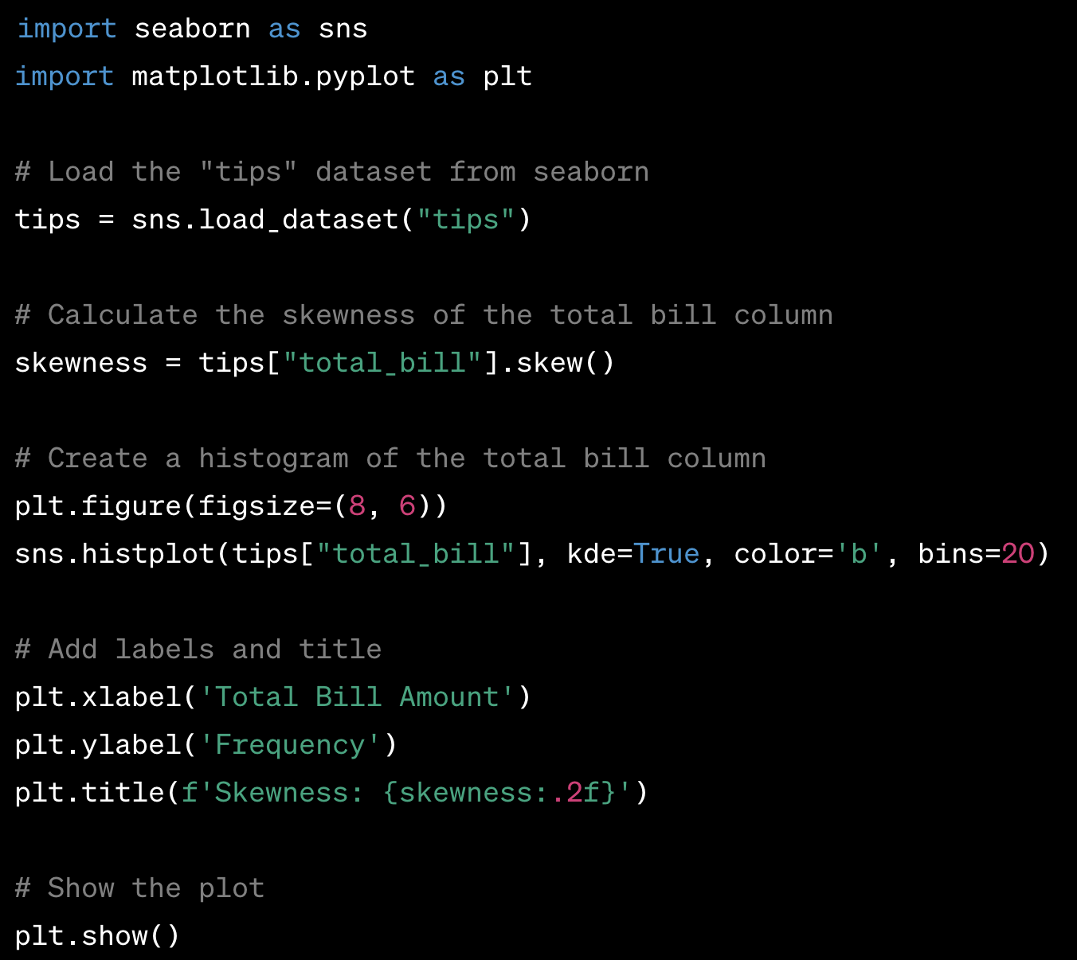
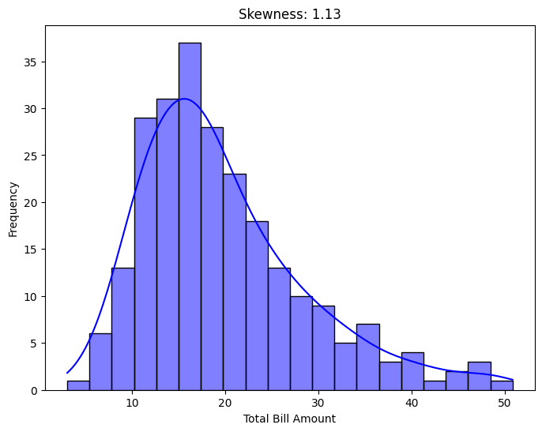
Skewness
Skewness is a measure of the asymmetry of the probability distribution of a random variable about its mean. It can be used to determine the direction and degree of skew (departure from horizontal symmetry) in the data. A negative skewness indicates a distribution that is skewed towards the left, while a positive skewness indicates a distribution that is skewed to the right.
Notes:
On of common usage of PDF is for testing. We usually use Goodness-of-fit tests are used to determine if a sample comes from a specified distribution, for example normal distribution. In other words, it helps to determine the suitability of a distribution to a dataset.
Some of the non-parametric methods are listed here.
Kolmogorov-Smirnov Test (K-S Test): This is a non-parametric test that compares the cumulative distribution function (CDF) of the sample data with the CDF of a specified theoretical distribution or another empirical distribution.
Anderson-Darling Test: This test gives more weight to the tails than the K-S test. It's used to test data against a number of distributions (including normal, exponential, and logistic).
Shapiro-Wilk Test: This test specifically tests for the normality of data. It's a widely accepted test for this purpose.
Lilliefors Test: This is an adaptation of the K-S test for situations where parameters are estimated from the data. It's often used when the sample size is small.
Using these tests on the Tips dataset, one can determine if the 'total_bill' column (or any other numeric column) follows a normal distribution or not. You can ask ChatGPT to give sample codes for tips dataset and here is the result.
P-value: For all the tests, if the p-value is less than a chosen alpha level (e.g., 0.05), the null hypothesis that the data comes from the chosen distribution is rejected.
For the Anderson-Darling test, the test statistic is compared with critical values at various significance levels. If the statistic is larger than the critical value, then for that significance level, the null hypothesis that the data comes from the chosen distribution is rejected.

Slide 15

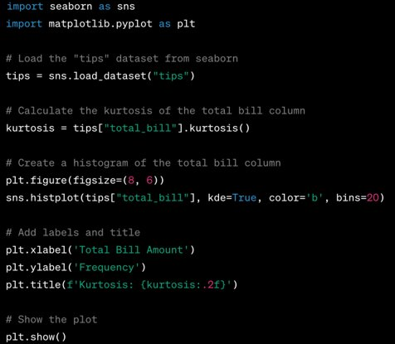
Kurtosis
Kurtosis is a statistical measure used to describe the distribution of observed data around the mean. It can be used to identify the peak and tails behavior of a distribution.
Notes:
Now lets also recall what is Kurtosis.
Kurtosis is a statistical measure used to describe the distribution of observed data around the mean. It can be used to identify the peak and tails behavior of a distribution.
In essence, kurtosis identifies whether the tails of a given distribution contain extreme values (outliers) or not, and if the data is light-tailed or heavy-tailed when compared to a normal distribution.
There are three types of kurtosis:
Mesokurtic (Kurtosis ~ 0 or 3): This distribution has kurtosis statistic similar to that of the normal distribution. It means the extreme values of the distribution are similar to that of a normal distribution.
Leptokurtic (Kurtosis > 3): A distribution that has tails which are fatter than the normal distribution. This leads to a distribution that has more outliers than a normal distribution.
Platykurtic (Kurtosis < 3): A distribution with tails thinner than a normal distribution, meaning it has fewer outliers than the normal distribution.
In data analysis, understanding the kurtosis of a dataset can be useful because it can indicate the presence of outliers which may need to be addressed, especially in machine learning contexts where outliers can significantly impact the performance of a model.
Let's compute the kurtosis for the total_bill column of the Tips dataset. From the kurtosis value, you can infer the tail behavior of the total_bill distribution. A histogram or density plot can help in visualizing this, giving a clearer picture of the peak and tails of the distribution.

Slide 16
Summary
Probability Density Functions (PDFs)
Histogram
PMF
CDF
Kernel Density Estimations (KDEs)
Skewness and Kurtosis
Notes:
Selamat, kita telah sampai di akhir materi kali ini! CDF, atau Cumulative Distribution Function, adalah alat yang sangat berguna dalam analisis data awal (EDA) dan memberikan banyak keuntungan dalam memahami distribusi data.
Mari kita rekap beberapa hal yang telah kita pelajari:
Memvisualisasikan Distribusi:
CDF memberikan ringkasan visual yang jelas dari data, menunjukkan probabilitas suatu nilai muncul dalam data.
Tidak seperti histogram, CDF tidak dipengaruhi oleh ukuran bin atau bandwidth, memberikan gambaran yang lebih konsisten dan jelas.
Membandingkan Distribusi:
Jika kamu memiliki beberapa grup data, menampilkan CDF mereka dalam satu grafik bisa membantu memahami perbedaan atau kesamaan.
Statistik Berdasarkan Persentil:
Dengan CDF, menemukan persentil tertentu menjadi mudah, seperti kuartil atau median.
Kamu juga bisa melihat di mana suatu nilai berdiri dalam distribusi.
Mengidentifikasi Outlier:
Dengan melihat ke ujung-ujung CDF, kita bisa menemukan nilai yang mungkin dianggap outlier.
Menangani Kemiringan:
CDF membantu kita melihat kemiringan dalam distribusi dan mempertimbangkan apakah transformasi diperlukan.
Mengecek Kesesuaian Distribusi:
Kita bisa membandingkan CDF dari data asli dengan distribusi teoritis untuk menilai seberapa baik mereka cocok.
Semoga materi hari ini bisa membantu kamu dalam meningkatkan kemampuan sebagai Data Scientist di masa depan. Terima kasih telah bersama kami dalam sesi ini! Selamat belajar dan terus eksplorasi dunia data!
Was this response better or worse?
BetterWorseSame

Slide 17
Quiz
Quiz 1: What is a Probability Density Function (PDF)? a) A function that gives the probability of a discrete random event. b) A function that maps each outcome to the likelihood of observing a given range of continuous values. c) A function that accumulates the probabilities for all possible outcomes. d) A function that represents the distribution of a categorical variable. Correct Answer: b) A function that maps each outcome to the likelihood of observing a given range of continuous values.
Quiz 2: Which of the following best describes skewness in a PDF? a) It measures the "tailedness" of the distribution. b) It measures how flat or peaked a distribution is. c) It measures the asymmetry of a distribution around its mean. d) It measures the width of the distribution's peak. Correct Answer: c) It measures the asymmetry of a distribution around its mean.
Quiz 3: What does Kernel Density Estimation (KDE) primarily help with in the context of PDFs? a) It helps in the estimation of the central tendency. b) It aids in the creation of a smooth curve over the data points to estimate the PDF. c) It helps in calculating the skewness of a distribution. d) It assists in determining the correlation between two variables. Correct Answer: b) It aids in the creation of a smooth curve over the data points to estimate the PDF.

Slide 18
Relationship Between Variables​
Kalbe Digital University
Notes:
Welcome back to Exploratory Data Analysis course. In this lecture we will learn about relationship between variables. Remember, EDA is about exploring the data and understanding its structure, main patterns, anomalies, and relationships among variables. Tools and techniques we will learn in this lecture are just a starting point, and deeper statistical analyses might be required based on initial findings.​
​
Lets start this lecture with outline. ​

Slide 19
1
Scatter Plot
2
Characterizing Relationships
Outline
3
Correlation Analysis
4
Covariance Analysis
of
5
Pearson’s Correlation
6
Nonlinear Relationship
Relationship Between Variables​
7
Spearman’s Rank Correlation
8
Correlation and Causation
9
Summary
Notes:
In this lecture we will learn about many methods and techniques like: ​
​
Scatter Plots. This plot is a visual representation where each value in the dataset is represented by a dot. ​
Characterizing Relationships. Positive Linear Relationship happened when both variables increase or decrease simultaneously. Negative Linear Relationship happened when one variable increases as the other decreases. In case of no Relationship, there’s no apparent trend.​
Correlation. This method is a statistical technique that can show whether and how strongly pairs of variables are related.​
Covariance. This technique is a measure indicating the extent to which two random variables change in tandem. ​
Pearson’s Correlation. It's a measure of the linear relationship between two variables. It's the standardized form of covariance, providing both direction and strength of the linear relationship between two variables.​
Nonlinear Relationships. Not all relationships are linear. A nonlinear relationship suggests that as one variable changes, the effect on another variable isn't consistent. Scatter plots are especially useful to detect non-linear relationships.​
Spearman’s Rank Correlation. It's a non-parametric measure of rank correlation. Instead of comparing means and variances, Spearman’s Rank Correlation considers the rank order of values.​
Correlation and Causation. Just because two variables are correlated doesn't mean that one causes the other. It's possible for two variables to be correlated because they are both being influenced by a third unseen factor (confounding variable).​
​
Lets start our lecture from scatter plot. ​
​

Slide 20
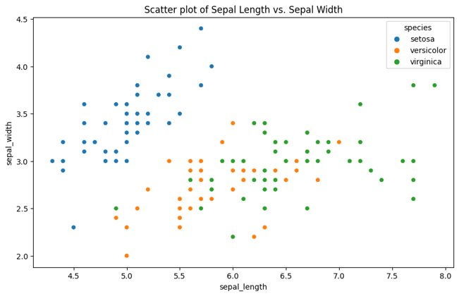
Scatter Plot​
Scatter plots are a foundational tool in EDA to visualize and understand relationships between two quantitative variables. ​​
Interpretation: ​
Positive Relationship​
Negative Relationship​
No Relationship​
Strength of Relationship​
Variations and Enhancements: ​
Color Coding, Size Variations, and Fit Lines​
Limitation:​
Overplotting and Linear Focus​
ChatGPT Prompt: Use Irish dataset, write sample code for scatter plot and analyze the result using Pandas and Seaborn. ​
Notes:
A scatter plot is one of the most effective graphical representations for analyzing the relationship between two quantitative variables. A scatter plot displays values for two variables using dots on a two-dimensional graph, where the horizontal axis represents one variable and the vertical axis represents the other. Each dot on the scatter plot represents a single observation from the dataset, with its position determined by the values of the two variables. Scatter plots provide immediate visual feedback about the nature, direction, and strength of relationships and can set the stage for more complex analyses.​
​
Interpreting Scatter Plots:​
Positive Relationship: If, generally, the dots tend to rise, meaning that as values for the x-axis increase so do the values for the y-axis, then the variables are positively correlated.​
Negative Relationship: If the dots tend to fall, meaning that as values for the x-axis increase the values for the y-axis decrease, then the variables are negatively correlated.​
No Relationship: If the dots form a shapeless cloud without any discernible direction, there may be no correlation between the variables.​
Strength of Relationship: The closer the dots are to forming a straight line, the stronger the linear relationship between the two variables.​
Variations and Enhancements:​
Color Coding: Dots can be color-coded based on another categorical variable, which can help in identifying patterns based on categories.​
Size Variations: The size of dots can represent another quantitative variable, offering a way to include a third variable in the analysis.​
Fit Lines: Lines (e.g., linear regression lines) can be added to highlight the relationship or trend in the data.​
Limitations:​
Overplotting: In datasets with a large number of points, dots can overlap, making it challenging to see individual observations or discern patterns.​
Linear Focus: Standard scatter plots are great for spotting linear relationships, but non-linear relationships might be less evident.​
Applications:​
Scatter plots are used across many fields, from economics (e.g., plotting GDP against unemployment rates) to biology (e.g., comparing height and weight of individuals) to technology (e.g., comparing CPU usage and response time for servers).​
​ Using ChatGPT, you can prompt simple example using Irish dataset. In the picture, the x-axis represents the sepal length and the y-axis represents the sepal width. The data points are color-coded based on the species of the flower. From the plot, we can observe that the setosa species typically has smaller sepal lengths but higher sepal widths compared to the other species. The versicolor and virginica species are somewhat overlapped in terms of sepal dimensions, but there's still a general trend where virginica flowers tend to have larger sepals in both length and width than versicolor flowers. There might be some outliers, especially in the virginica and versicolor clusters. Using scatter plots with the hue parameter in Seaborn is beneficial as it provides more insight into the data by categorizing it based on another variable (in this case, the species of the flower). You can further analyze relationships by plotting scatter plots for other variable combinations, like petal length vs. petal width.​
​

Slide 21
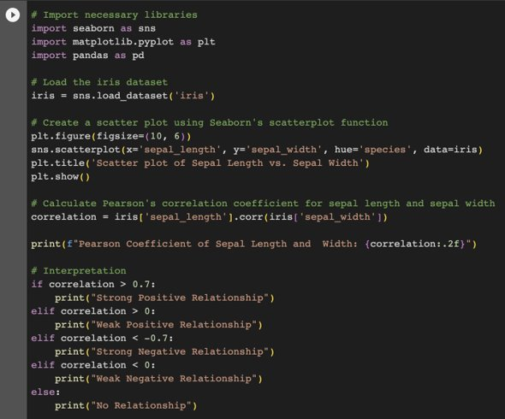
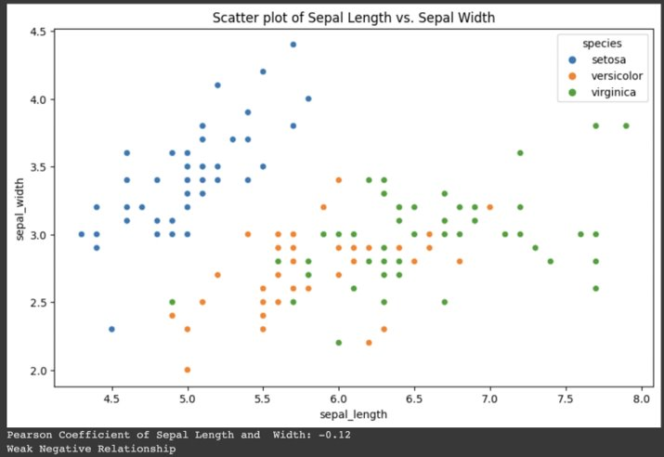
Scatter Plot Interpretation​
Notes:
How to interpret the Scatter plot? First thing to do is visual interpretation. From a scatter plot of the Iris dataset, you can interpret relationships as:​
​
Positive Relationship: If as the values on the x-axis increase, the values on the y-axis also increase, and the dots tend to rise, it indicates a positive relationship. In the context of the Iris dataset, if we observe that as sepal length increases, sepal width also tends to increase for a particular species, then there's a positive relationship between sepal length and width for that species.​
Negative Relationship: If as the values on the x-axis increase, the values on the y-axis decrease, and the dots tend to fall, it indicates a negative relationship. For the Iris dataset, this would mean that longer sepals correspond with narrower sepals for a particular species.​
No Relationship: If the dots form a shapeless cloud without any discernible direction, then there may be no correlation or relationship between the two variables being observed.​
Strength of Relationship: The strength can be seen in how closely the points follow a discernible pattern:​
Strong Relationship: Points are closely packed together following a clear trend.​
Weak Relationship: Points are more scattered.​
​
Next, to quantify these relationships, we often use correlation measures. The most common measure is Pearson's correlation coefficient. It measures the strength and direction of a linear relationship between two variables. ​
​
You can use ChatGPT to get sample codes on Pearson correlation. We will learn more about correlation later.​
​
​
​

Slide 22
Characterizing Relationship​
Visual Methods:​
Scatter Plots​
Box Plots​
Pair Plots​
Heatmaps​
Correlation Techniques: ​
Pearson​
Spearman​
Kendall​
Categorical Relationships: ​
Contingency Tables​
Staked Bar Charts​
Statistical Tests: ​
T-Test and ANOVA​
Chi-Square Test​
Regression Analysis​
Staked Bar Charts​
ChatGPT Prompt: Use Irish dataset, write sample code for Scatter plot and analyze the result using Pandas and Seaborn. ​
ChatGPT Prompt: Use Irish dataset, write sample code for Pearson correlation analysis and interpret the result using Pandas and Seaborn. ​
ChatGPT Prompt: Use Irish dataset, write sample code for Categorical Relationship with Contingency tables and interpret the result using Pandas and Seaborn. ​
ChatGPT Prompt: Use Irish dataset, write sample code to implement T-Test and ANOVA then analyze the result using Pandas, Scipy and Seaborn. ​
Notes:
In EDA, characterizing the relationship between variables is essential for understanding the underlying patterns and structures in your data. Several techniques and methods can be employed, depending on the type and distribution of the data. ​
​
Here are some of the most common methods:​
​
Visual Methods:​
Scatter Plots: As already discussed, scatter plots provide a graphical view of the relationship between two numerical variables. Patterns, trends, and clusters can be quickly identified.​
Box Plots: For a categorical and a numerical variable, box plots can show the distribution of the numerical variable across different categories.​
Pair Plots: If you have many numerical variables, pair plots (or scatter plot matrices) can be useful. They plot every combination of variables against each other.​
Heatmaps: Useful for visualizing the correlation matrix of multiple variables. Colors can quickly show the strength and direction of relationships.​
Correlation Techniques:​
Pearson's Correlation: Measures the linear relationship between two numerical variables.​
Spearman's Rank Correlation: Measures the monotonic relationship between two variables. Useful when the relationship might be non-linear or when dealing with ordinal data.​
Kendall's Tau: Similar to Spearman's, but based on the concordant and discordant pairs. It's computationally more intensive but can be more accurate in certain scenarios.​
Categorical Relationships:​
Contingency Tables: Also known as cross-tabulations. These tables show the distribution of one categorical variable as per the categories of another. Chi-square tests can then be used to test the independence of the variables.​
Stacked Bar Charts: Visual representation of the distribution of a categorical variable across the categories of another.​
Statistical Tests:​
T-tests and ANOVA: Compare means between two or more groups. Useful for understanding if there's a significant difference in the means of numerical variables across different categories of a categorical variable.​
Chi-square Test: Tests the independence of two categorical variables.​
Regression Analysis: Helps in understanding the relationship between one dependent variable and one (or more) independent variables. It provides both the strength and the form of the relationship.​
​
During EDA, it's not uncommon to use multiple methods in tandem. The goal is to gain a comprehensive understanding of the data, and different techniques often provide complementary insights. Remember that the choice of method largely depends on the type of data you're dealing with (numerical, categorical, ordinal, etc.) and the specific questions you're trying to answer. You can always use ChatGPT to generate sample codes on each method and adapt the results to your data. Here are some useful prompts that you can expand based on your needs. ​
​

Slide 23
Correlation Analysis​
The correlation analysis is pivotal for understanding the relationship between two or more variables in a dataset. ​
​
Common Methods and Techniques: ​
Pearson’s Correlation Coefficient​
Spearman’s Rank Correlation​
Kendal Tau​
Common Methods and Techniques: ​
Point-Biserial Correlation​
Phi Coefficient *​
Categorical Correlation​
Correlation Heatmaps​
Regression Analysis​
Partial Correlation​
Cross Correlation​
Spearman’s Rank Correlation​
Kendal Tau​
​
Key Considerations: ​
Correlation does not imply causation​
Statistical Significance​
Outlier Identification​
Distribution ​
ChatGPT Prompt: Use publicly available dataset, write sample code for Phi Coefficient and interpret the result using Pandas, SciPy and Seaborn. ​
Notes:
Now we will explore more about correlation analysis between variables. In the realm of EDA, the correlation analysis is pivotal for understanding the relationship between two or more variables in a dataset. The main objective of correlation analysis is to discern if and how strongly pairs of variables are related. ​
​
Here are some of the most commonly employed methods and techniques for correlation analysis:​
​
Pearson's Correlation Coefficient:​
It measures the linear relationship between two continuous variables.The coefficient can range from -1 to 1:​
-1 indicates a perfect negative linear relationship.​
0 indicates no linear relationship.​
1 indicates a perfect positive linear relationship.​
Use cases: Ideal for variables with a linear relationship and that are approximately normally distributed.​
Spearman's Rank Correlation:​
It assesses how well the relationship between two variables can be described using a monotonic function. Unlike Pearson's, it's non-parametric and measures the strength and direction of the monotonic relationship between two paired data.​
Use cases: Useful when the relationship between variables is not linear, or when data is ordinal or not normally distributed.​
Kendall's Tau:​
It's another non-parametric test that measures the strength of dependence between two variables. It's based on the concept of concordant and discordant pairs.​
Use cases: Like Spearman's, it's suited for non-linear relationships and non-normally distributed data, but it's often used when there are small amounts of data or lots of tied ranks.​
​
We will learn about Pearson, Spearman and Kendall in this lecture. However, there are many more methods and techniques you can use such as: ​
​
Point-Biserial Correlation: It measures the strength and direction of the association between one continuous variable and one binary categorical variable.​
Phi Coefficient: A measure of association for two binary variables.​
Categorical Correlation (Cramér's V): For nominal (categorical) data. It is based on the chi-squared statistic to provide a measure of association between two categorical variables.​
Correlation Heatmaps: It's a visualization tool often used in conjunction with the above metrics, especially in datasets with multiple variables. It provides a color-coded matrix to easily discern the strength and direction of relationships among multiple variables.​
Regression Analysis: Beyond basic correlation, regression analysis (like linear regression) can also be used to quantify the strength of the relationship between variables and even predict values.​
Partial Correlation: Measures the degree of association between two random variables while keeping the effect of one or more other variables fixed or constant.​
Cross-Correlation: Used for time series data to measure the similarity between two sequences as a function of the time lag applied to one of them.​
​
​
During the implementation of correlation analysis, some considerations here are important. ​
Correlation does not imply causation: Even if two variables are correlated, it doesn’t mean that changes in one variable cause changes in another.​
Significance: A correlation coefficient can be statistically significant without being practically significant.​
Outliers: Correlation is sensitive to outliers. An outlier can distort the interpretation of a strong relationship or can suggest a relationship where none exists.​
Distribution: The distribution of the variables plays a crucial role in choosing the right correlation method. For instance, Pearson's is best suited for normally distributed continuous variables, whereas Spearman's can be used for ordinal or non-normally distributed data.​
​
In EDA, understanding correlations can help in feature selection, model building, and in deriving insights from the data regarding how variables interact with one another. ​
​
In term of practical implementation, ChatGPT can help as assistant to give you sample codes. Here is sample prompt you can use and customize for each methods and techniques. ​
​

Slide 24
Covariance Analysis​
The coveriance analysis is pivotal for understanding how two variables change together. If one variable tends to go up when the other goes up, there's a positive covariance. If one variable tends to go down when the other goes up, there's a negative covariance.​
​
Common Methods and Techniques: ​
Covariance Matrix​
Pearson’s Correlation Coefficient​
Scatter Plots​
Bivariate Analysis *​
Linear Regression Analysis​
Key Considerations: ​
ChatGPT Prompt: Use publicly available dataset, write sample code for Bivariate Analysis and interpret the result using Pandas, SciPy and Seaborn. ​
ChatGPT Prompt: Use publicly available dataset, write sample code for Bivariate Analysis and interpret the result using Pandas, SciPy and Seaborn. ​
Notes:
In exploratory data analysis (EDA), covariance is a key statistical metric that helps in understanding how two variables change together. If one variable tends to go up when the other goes up, there's a positive covariance. If one variable tends to go down when the other goes up, there's a negative covariance.​
Here are some common methods and techniques related to covariance analysis:​
​
Covariance Matrix:​
This is a matrix where each element is the covariance between two variables.​
It's symmetric, with variances on the diagonal and covariances off the diagonal.​
It provides a summarized view of how all variables (columns) in a dataset change with respect to each other.​
Pearson's Correlation Coefficient:​
It is a normalized measure of the linear relationship between two variables.​
The formula for Pearson's correlation divides the covariance of the two variables by the product of their standard deviations.​
Scatter Plots:​
Scatter plots allow for visual inspection of the relationship between two variables.​
The pattern or direction of the spread of points can give insights into the covariance; if points are scattered from bottom left to top right, the covariance may be positive, while scattering from top left to bottom right suggests negative covariance.​
Bivariate Analysis:​
Involves the analysis of two variables, often with the goal to understand the relationship and covariance structure between them.​
This can include scatter plots, pair plots (in the case of multiple variables), and calculating correlation matrices.​
Linear Regression Analysis:​
Covariance plays a role in linear regression, especially in understanding how the dependent and independent variables change together.​
The slope of the regression line, especially in simple linear regression, is directly influenced by the covariance between the dependent and independent variables.​
Multivariate Analysis:​
In more advanced statistics, techniques like Principal Component Analysis (PCA) consider the covariance matrix to reduce the dimensionality of data.​
​
We will learn some of those methods and techniques in this lecture. Some key considerations on implementing covariance analysis are: ​
Scale Sensitivity: Unlike correlation, which is dimensionless and always in the range of -1 to 1, covariance is influenced by the scale of the variables. Thus, a large covariance might not necessarily imply a strong relationship between variables.​
Interpretation:​
Positive Covariance: Indicates that two variables tend to increase or decrease together.​
Negative Covariance: Implies that as one variable increases, the other tends to decrease, and vice versa.​
Covariance Close to 0: The variables do not show much linear dependence.​
Normalization: To get a normalized measure of the strength and direction of the linear relationship between two variables, it's often more useful to compute the Pearson correlation coefficient, which essentially scales the covariance.​
​
In EDA, understanding covariance can be instrumental in feature selection and modeling since it helps identify which variables have strong linear relationships with others. This is crucial when trying to avoid multicollinearity in regression models or when aiming to reduce dimensionality. Again, you can always use ChatGPT to get sample codes in your exploration. ​
​
​

Slide 25
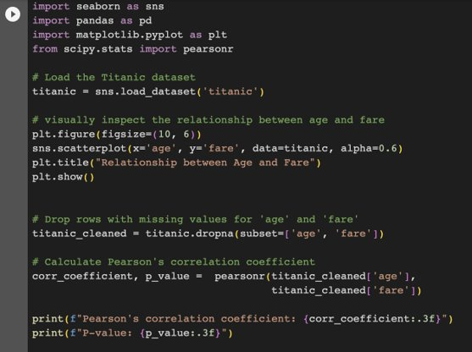
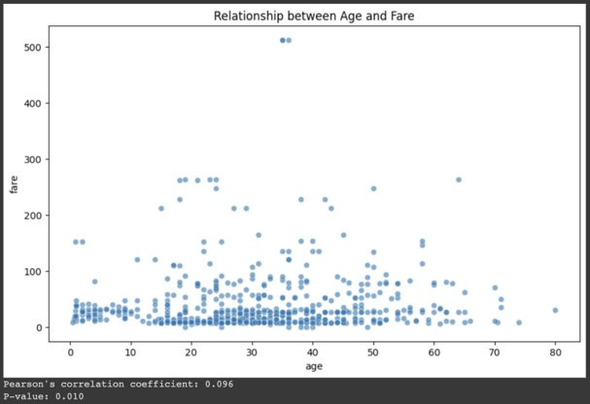
Pearson’s Correlation Coefficient​
Pearson's correlation coefficient, denoted as r, measures the linear relationship between two datasets. It's a value between -1 and 1 inclusive, where:1 indicates a perfect positive linear relationship (Wikipedia).​
-1 indicates a perfect negative linear relationship.​
0 indicates no linear correlation between the variables.​
Notes:
In statistics, the Pearson correlation coefficient (PCC) is a correlation coefficient that measures linear correlation between two sets of data. It is the ratio between the covariance of two variables and the product of their standard deviations; thus, it is essentially a normalized measurement of the covariance, such that the result always has a value between −1 and 1. As with covariance itself, the measure can only reflect a linear correlation of variables, and ignores many other types of relationships or correlations. As a simple example, one would expect the age and height of a sample of teenagers from a high school to have a Pearson correlation coefficient significantly greater than 0, but less than 1 (as 1 would represent an unrealistically perfect correlation). A common misinterpretation is assuming that correlation implies causation. Just because two variables are correlated does not mean changes in one cause changes in the other. There may be lurking or confounding variables that explain the relationship or the observed association might be coincidental.​
​
Let see practical example using the Titanic dataset from Seaborn to conduct Pearson’s Correlation Coefficient analysis. We'll analyze the relationship between age and fare in the dataset. This visualization provides an overview of the relationship. A clear trend (upward or downward) suggests a stronger correlation, while a more random dispersion indicates a weaker or no correlation.​
​
On the Pearson's Correlation Coefficient:​
Value: As previously mentioned, values close to 1 indicate a strong positive linear relationship, values close to -1 indicate a strong negative linear relationship, and values close to 0 suggest a weak or no linear relationship.​
P-value: This helps in determining the statistical significance of the observed correlation. Typically, a p-value less than 0.05 is considered statistically significant. This would mean that there's strong evidence to suggest the observed correlation in the sample also exists in the population.​
​
In the context of the Titanic dataset, a statistically significant correlation (based on p-value) would suggest that there's some linear relationship between age and fare in the overall population from which this dataset is drawn. However, the correlation coefficient's value itself will indicate the strength and direction of this linear relationship.​
​
You can use ChatGPT to get more example using other public dataset available in Seaborn or Pandas. ​
​
​
​
​

Slide 26
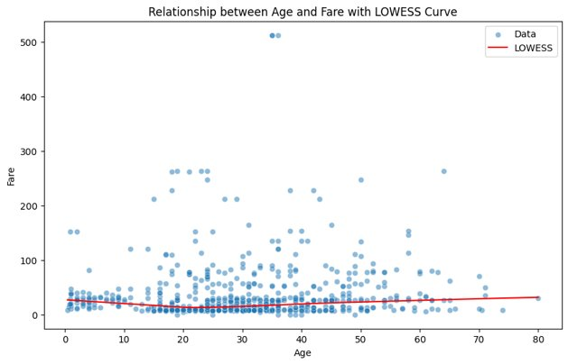
Nonlinear Relationship​
Linear relationships are straightforward and well-understood, but real-world data often contains nonlinear relationships. ​
​
Common Methods and Techniques: ​
Scatter Plots​
Polynomial and Spline Regression​
Transformations​
Locally Weighted Scatterplot Smoothing (LOWESS or LOESS)* ​
Distance-based Methods​
Decision Trees and Random Forests​
Residual Plots​
Neural Networks​
Generalized Additive Models​
ChatGPT Prompt: Use publicly available dataset, write sample code for LOWESS implementation to learn nonlinear relationship and interpret the result using Pandas, SciPy and Seaborn. ​
Notes:
Linear relationships are straightforward and well-understood, but real-world data often contains nonlinear relationships. ​
​
Here are some common methods and techniques to detect and measure nonlinear relationships between variables:​
​
Scatter Plots:​
Before any statistical method, visual inspection through scatter plots can give an initial sense of the relationship between variables. Patterns like curves, clusters, or other non-linear shapes may indicate a nonlinear relationship.​
Polynomial and Spline Regression:​
This allows you to fit a nonlinear relationship by adding polynomial terms or using spline functions. ​
Transformations:​
Applying functions like logarithm, square root, or other mathematical functions can sometimes linearize relationships, making them easier to model and understand.​
Locally Weighted Scatterplot Smoothing (LOWESS or LOESS):​
It provides a smooth curve that captures the relationship between variables in the scatter plot. This curve can help visualize non-linear relationships.​
Distance-based Methods:​
Methods like the Mutual Information metric measure the dependency between variables. This metric can capture any kind of relationship, linear or nonlinear.​
Decision Trees and Random Forests:​
These machine learning methods can capture and quantify nonlinear relationships in their structure. For instance, a decision tree might split data based on a certain threshold of one variable, which can be indicative of a nonlinear relationship.​
Residual Plots:​
After fitting a linear regression model, if the residuals show patterns when plotted against the predicted values or any independent variable, it can indicate non-linearity. Ideally, in a perfect linear relationship, residuals should show no pattern and be randomly scattered.​
Neural Networks:​
These can capture complex nonlinear relationships but may require a significant amount of data and might be more challenging to interpret.​
GAM (Generalized Additive Models):​
These are a combination of simpler models to predict the dependent variable based on different transformations of the independent variables, allowing for the capture of non-linear relationships.​
​ ​
Always remember that the complexity of the method should match the purpose of the analysis. For inferential tasks, simpler and interpretable methods are often better, while for prediction, more complex methods might be more appropriate. We cant cover all of those methods in this lecture, but if you are curious, for each of those methods you can easily use prompt engineering to get Python sample codes. Here is example scatter plot with LOWESS analysis using Titanic dataset. ​

Slide 27
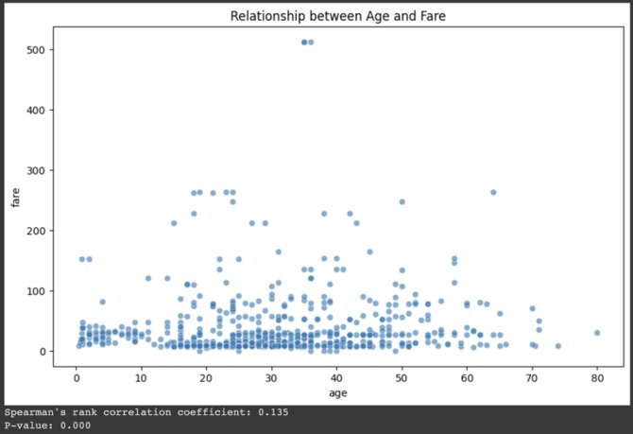
Spearman’s Rank Correlation​
Spearman’s Rank Correlation is a non-parametric measure of correlation that assesses the monotonic relationship between two variables. It's especially useful when your data isn't normally distributed or has a nonlinear relationship (Wikipedia). ​
​
ρ=1: Perfect positive rank correlation​
ρ=−1: Perfect negative rank correlation​
ρ=0: No rank correlation​
​
Notes:
In statistics, Spearman's rank correlation coefficient or Spearman's ρ, named after Charles Spearman. It is a nonparametric measure of rank correlation (statistical dependence between the rankings of two variables). It assesses how well the relationship between two variables can be described using a monotonic function.​
The Spearman correlation between two variables is equal to the Pearson correlation between the rank values of those two variables; while Pearson's correlation assesses linear relationships, Spearman's correlation assesses monotonic relationships (whether linear or not). If there are no repeated data values, a perfect Spearman correlation of +1 or −1 occurs when each of the variables is a perfect monotone function of the other. Intuitively, the Spearman correlation between two variables will be high when observations have a similar (or identical for a correlation of 1) rank (i.e. relative position label of the observations within the variable: 1st, 2nd, 3rd, etc.) between the two variables, and low when observations have a dissimilar (or fully opposed for a correlation of −1) rank between the two variables. Spearman's coefficient is appropriate for both continuous and discrete ordinal variables. Both Spearman's and Kendall's can be formulated as special cases of a more general correlation coefficient. The resulting coefficient, denoted as ρ (rho), varies between -1 and 1. ρ=1 has Perfect positive rank correlation. ρ=−1 has Perfect negative rank correlation. And ρ=0 has No rank correlation. ​
​
Here is the example of relationship between age and fare in Titanic dataset. Scatter Plot here provides a visual representation of the relationship between variables. ​
​
Result for Spearman's Rank Correlation Coefficient:​
Value: As discussed, values close to 1 indicate a strong positive monotonic relationship, values close to -1 indicate a strong negative monotonic relationship, and values close to 0 suggest a weak or no monotonic relationship.​
P-value: It determines the statistical significance of the observed correlation. Typically, a p-value less than 0.05 is considered statistically significant, suggesting that there's evidence that the observed correlation in the sample also exists in the population.​
​
From the Titanic dataset, if there's a statistically significant correlation based on the p-value, it would suggest some monotonic relationship between age and fare. The coefficient's value would indicate the strength and direction of this relationship.​
​ ​

Slide 28
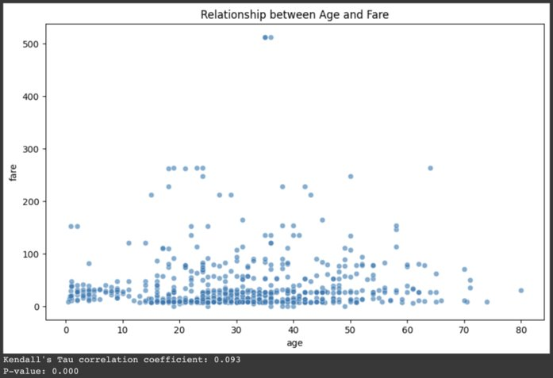
Kendall Tau Correlation​
The Kendall Tau rank correlation, commonly denoted as ττ (tau), is a non-parametric statistic used to measure the ordinal association between two quantities. It assesses the strength and direction of the monotonic relationship between two paired datasets (Wikipedia). ​
τ=1: Perfect agreement​
τ=−1: Perfect disagreement​
τ=0: No association​
​
Notes:
In statistics, the Kendall rank correlation coefficient, commonly referred to as Kendall's τ coefficient, is a statistic used to measure the ordinal association between two measured quantities. A τ test is a non-parametric hypothesis test for statistical dependence based on the τ coefficient. It is a measure of rank correlation: the similarity of the orderings of the data when ranked by each of the quantities. It is named after Maurice Kendall, who developed it in 1938, though Gustav Fechner had proposed a similar measure in the context of time series in 1897.​
​
Intuitively, the Kendall correlation between two variables will be high when observations have a similar rank (or identical for a correlation of 1). Both Kendall's and Spearman’s can be formulated as special cases of a more general correlation coefficient. Its notions of concordance and discordance also appear in other areas of statistics, like the Rand index in cluster analysis.​
​
Here is the example of relationship between age and fare in Titanic dataset. Scatter Plot provides a visual representation of the relationship between variables.​
​
Result for Kendall's Tau Correlation Coefficient:​
Value: Close to 1 indicates a strong positive monotonic relationship; close to -1 indicates a strong negative monotonic relationship; and close to 0 suggests a weak or no monotonic relationship.​
P-value: A p-value less than 0.05 typically suggests that the observed correlation is statistically significant.​
​
From the Titanic dataset, if the correlation is statistically significant based on the p-value, it would indicate some monotonic relationship between age and fare. The coefficient's value would reveal the strength and direction of this relationship.​
​

Slide 29
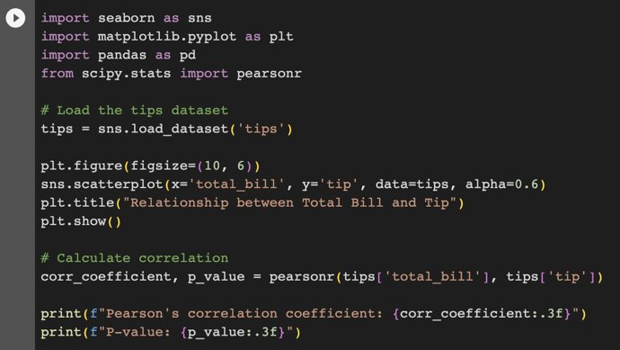
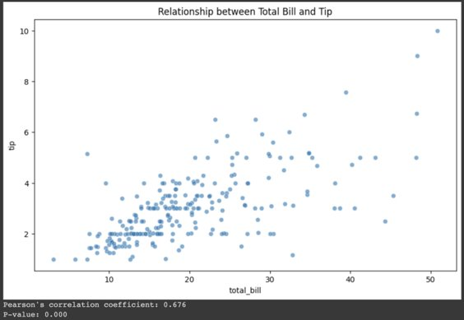
Correlation and Causation​
Correlation does not imply causation:​
Correlation refers to a statistical measure that describes the extent to which two variables change together.​
Causation implies that a change in one variable is responsible for a change in another. ​
​
Notes:
A common aphorism in EDA is: "Correlation does not imply causation." Just because two variables correlate strongly doesn't mean one caused the other.​
​
Correlation refers to a statistical measure that describes the extent to which two variables change together. If one variable tends to go up when the other goes up, there is a positive correlation. If one variable tends to go down when the other goes up, there is a negative correlation. However, correlation does not imply that changes in one variable are responsible for changes in another.​
Causation implies that a change in one variable is responsible for a change in another. For causation to be established, typically, controlled, randomized experiments or in-depth studies are required. In many observational studies, especially in fields like economics or epidemiology, finding true causal links can be very challenging.​
​
Let's take the tips dataset from Seaborn which gives information about the bills and tips given by different customers at a restaurant. We'll try to see if the total bill and tip are correlated. If you see a pattern in Scatter Plot, like an upward trend, it suggests there might be a correlation. A value closer to 1 or -1 indicates a strong correlation, while values closer to 0 indicate weaker correlations. Assuming we find a strong positive correlation between total bill and tip, this could mean that as bills increase, tips increase. However, this doesn't mean that just increasing the bill will always lead to higher tips (causation). There could be other underlying factors involved, like the quality of service, the mood of the diner, etc.​
​
In EDA, it's crucial to recognize correlations but be cautious and rigorous before drawing conclusions about causation.​
​
​

Slide 30
Summary​
What We Have Learnt About Relationship Between Variables: ​
Scatter Plot​
Correlation Analysis​
Covariance Analysis​
Pearson’s Correlation​
Spearman’s Rank Correlation​
Kendall Tau’s Correlation​
Correlation and Causation​
​
Notes:
We are arrived at the end of this lecture. We have learnt that understanding methods and techniques to evaluate relationships between variables is paramount in EDA. These techniques not only unearth hidden patterns and insights in the data but also aid in feature selection, predictive modeling, and hypothesis testing. Recognizing correlations can assist in avoiding multicollinearity, a situation where predictors in a model are correlated, which can distort results and interpretations. Moreover, distinguishing between correlation and causation ensures accurate conclusions, steering clear of misleading assumptions. In essence, a nuanced grasp of these methods bolsters the robustness and reliability of the analyses, leading to more informed decisions and strategies.​
​
Here is the summary of our lecture. ​
In the realm of Exploratory Data Analysis (EDA), understanding the relationship between variables plays a pivotal role. One of the foundational techniques to visualize these relationships is the scatter plot, which plots two variables on a graph to depict potential correlations. While scatter plots give a visual sense of the relationship, correlation and covariance analyses provide numerical measures. Correlation analysis measures the linear relationship between two variables, with the resulting coefficient ranging from -1 to 1, indicating negative, no, and positive relationships respectively. Covariance, on the other hand, provides a sense of direction in the relationship but doesn't normalize the scale, making interpretation less direct than correlation. Diving deeper, Pearson's Correlation quantifies linear relationships, while Spearman’s Rank and Kendall Tau’s Correlations are non-parametric measures, useful especially when data doesn't adhere to normality or when relationships are nonlinear.​
However, while these tools are powerful for understanding associations, it's imperative to differentiate between correlation and causation in EDA. A correlation, no matter how strong, does not imply that changes in one variable cause changes in another. Causation demands a deeper and more rigorous examination, often involving controlled experiments or detailed studies. The age-old adage, "correlation does not imply causation," encapsulates this critical distinction, reminding analysts to approach relationships with a healthy dose of skepticism and a quest for deeper understanding.​
​
​
​

Slide 31
Quizz​
Quiz 1: Scatter Plots​
Which of the following best describes a scatter plot?​
A plot showing the frequency of a single variable.​
A plot displaying the relationship between two numerical variables.​
A plot that shows the distribution of a dataset.​
A plot to display categories of a single variable.​
Correct Answer: B​
Quiz 2: Correlation Coefficients 2. Which of the following statements about Pearson’s Correlation Coefficient is true?​
It can have values only between 0 and 1.​
It assumes a linear relationship between two variables.​
It is best used for categorical variables.​
It can determine the causality between two variables.​
Correct Answer: B​
Quiz 3: Relationship Interpretation 3. If two variables, X and Y, have a strong positive Spearman’s Rank Correlation, which of the following can be concluded?​
Changes in X cause changes in Y.​
There is a strong linear relationship between X and Y.​
X and Y move in the same direction, but not necessarily at a constant rate.​
The relationship between X and Y is purely random.​
Correct Answer: C​
​

